Slide 1

Algebra 1
Unit 2, Lesson 6 Multiplying Binomials with Algebra Tiles Volume 1, pg. 85

Slide 2


Benchmark
MA.912.AR.1.3
Add, subtract, and multiply polynomial expressions with rational number coefficients.
volume 1, pg. 85

Slide 3
Integrated Mathematical Thinking and Reasoning Standards
MA.K12.MTR.2.1 Demonstrate understanding by representing problems in multiple ways.
MA.K12.MTR.4.1 Engage in discussions that reflect on the mathematical thinking of self and others.
MA.K12.MTR.5.1 Use patterns and structure to help understand and connect mathematical concepts.
volume 1, pg. 85

Slide 4

Learning Target
I can multiply binomials using algebra tiles.
volume 1, pg. 85

Slide 5

Warm-Up
volume 1, pg. 86

Slide 6
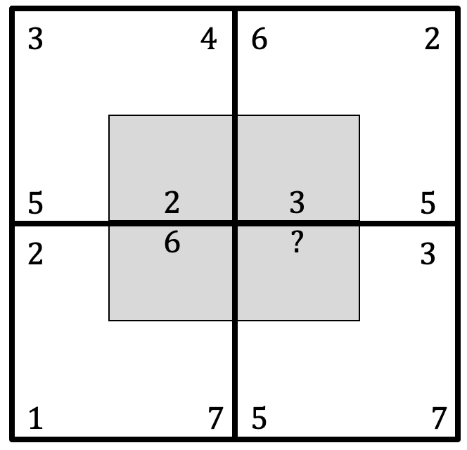
2.6.1 Warm-Up: Math Puzzle
A math puzzle is shown with one value missing.
Find the missing number in the puzzle.
Describe the pattern used to find the missing number.
volume 1, pg. 86
Notes:
Video Link: https://algebranation.wistia.com/medias/fi4fidi5y8

Slide 7

Exploration
volume 1, pg. 86

Slide 8

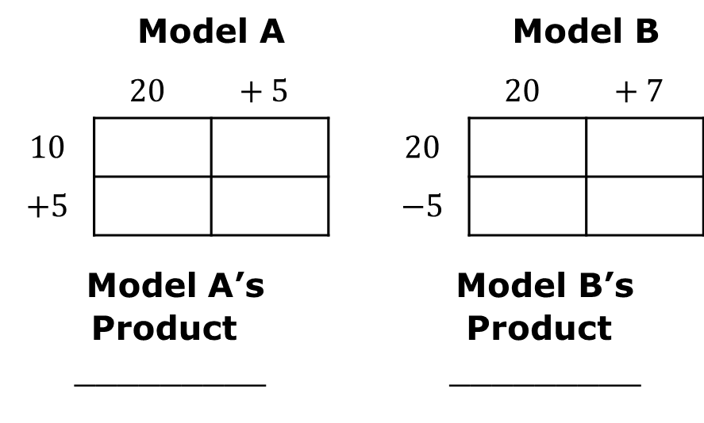
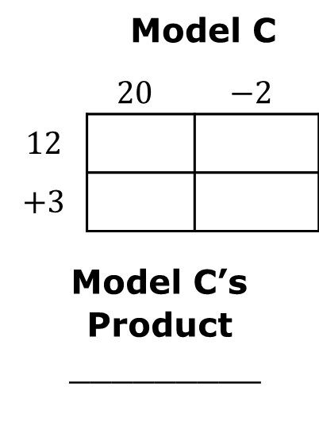
2.6.2 Exploration: Multiplying with the Area Model
Work with your partner to complete the following.
Three multiplication problems are set up using an area model.
Complete the area models to find each product.
 | Model A |  |  |  | Model B
 | $$20$$ | $$+ 5$$ |  |  | $$20$$ | $$+ 7$$
$$10$$ |  |  |  | $$20$$
$$+5$$ |  |  |  | $$−5$$
Model A’s Product _________ |  |  |  | Model B’s Product _________
 | Model C
 | $$20$$ | $$−2$$
$$12$$
$$+3$$
Model C’s Product _________
volume 1, pg. 86

Slide 9
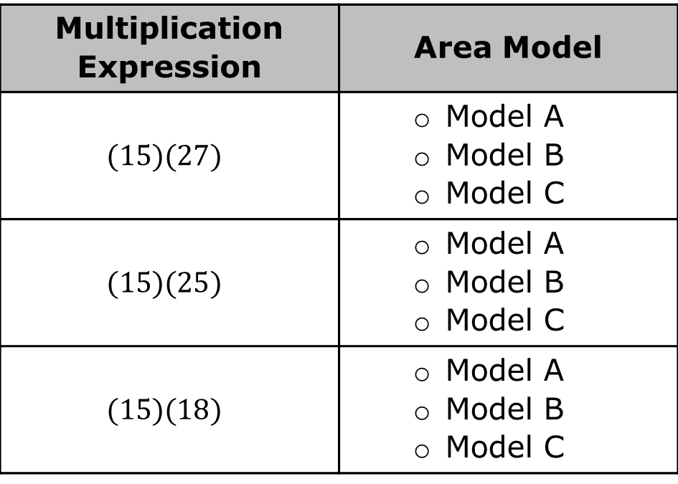
Match each area model to the multiplication expression it represents.
Multiplication Expression | Area Model
$$(15)(27)$$ | Model A Model B Model C
$$(15)(25)$$ | Model A Model B Model C
$$(15)(18)$$ | Model A Model B Model C
volume 1, pg. 87

Slide 10
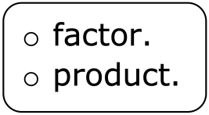
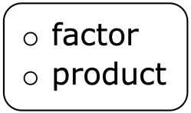
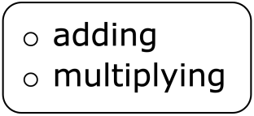
Complete the statements.
In the area models, each rectangle represents part of the Parts of each are multiplied to find four partial products. The product of the two factors is found by the partial products.
volume 1, pg. 87

Slide 11

Guided Instruction
volume 1, pg. 87

Slide 12

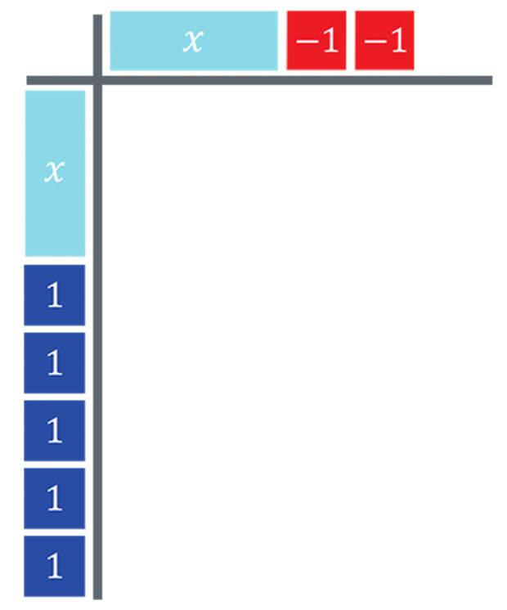
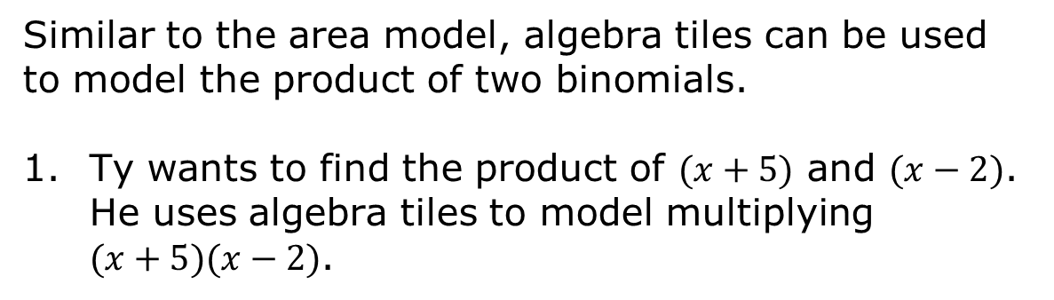
2.6.3 Guided Instruction: Multiplying Binomials
Similar to the area model, algebra tiles can be used to model the product of two binomials.
Ty wants to find the product of $(x+5)$ and $(x−2)$. He uses algebra tiles to model multiplying $(x+5)(x−2)$.
volume 1, pg. 87

Slide 13
Similar to the area model, the factors are placed along the width and the height of a rectangular area.
Discuss with your partner how each factor is represented using algebra tiles. Write a summary of your discussion.
volume 1, pg. 87

Slide 14
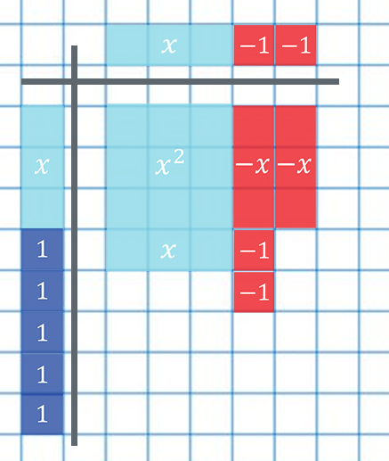
Complete Ty’s model to find the product of $(x+5)$ and $(x−2)$ by drawing and labeling the missing tiles.
volume 1, pg. 88

Slide 15

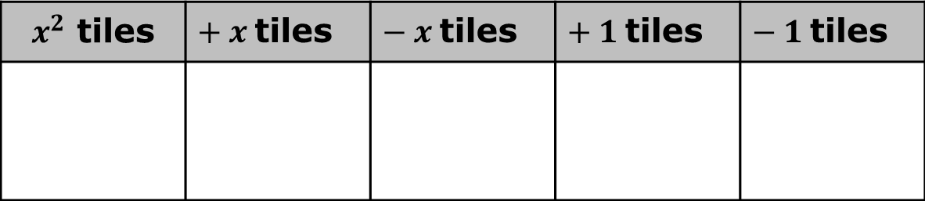
Determine how many of each tile are represented in the product and write the numbers in the table.
Complete the expression that represents the product of (𝑥+5) and (𝑥−2) using the algebra tiles.
$$(x+5)(x−2)= _____x^{2} + _____x − ______$$
$x^{2}$ tiles | ${+ x}^{ }$tiles | ${− x}^{ }$tiles | ${+ 1}^{ }$tiles | ${− 1}^{ }$tiles
volume 1, pg. 88

Slide 16
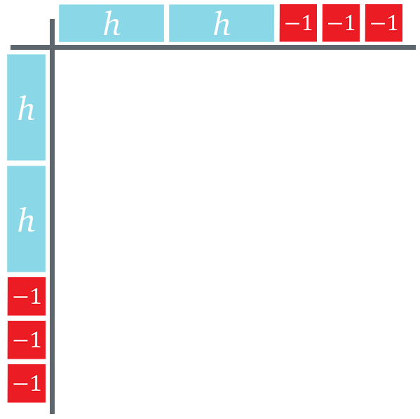
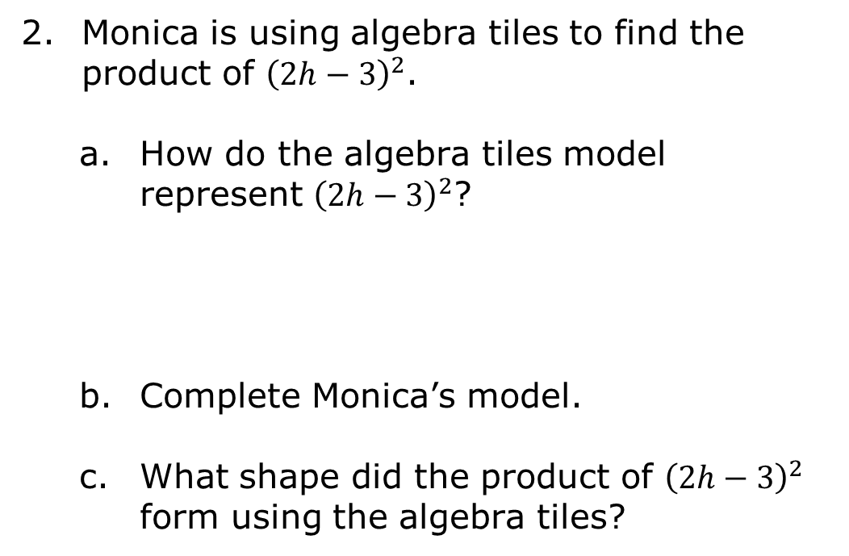
Monica is using algebra tiles to find the product of ${\left(2h−3\right)}^{2}$.
How do the algebra tiles model represent ${\left(2h−3\right)}^{2}$?
Complete Monica’s model.
What shape did the product of ${\left(2h−3\right)}^{2}$ form using the algebra tiles?
volume 1, pg. 88

Slide 17

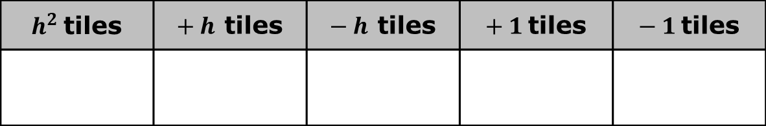
Remember when a value is “squared,” the value is being multiplied by itself.
Complete the table by writing how many of each tile are in the model of the product of ${\left(2h−3\right)}^{2}$.
Write the algebraic expression that represents the product of ${\left(2h−3\right)}^{2}$.
$h^{2}$tiles | ${+ h}^{ }$tiles | ${− h}^{ }$tiles | ${+ 1}^{ }$tiles | ${− 1}^{ }$tiles
volume 1, pg. 89

Slide 18
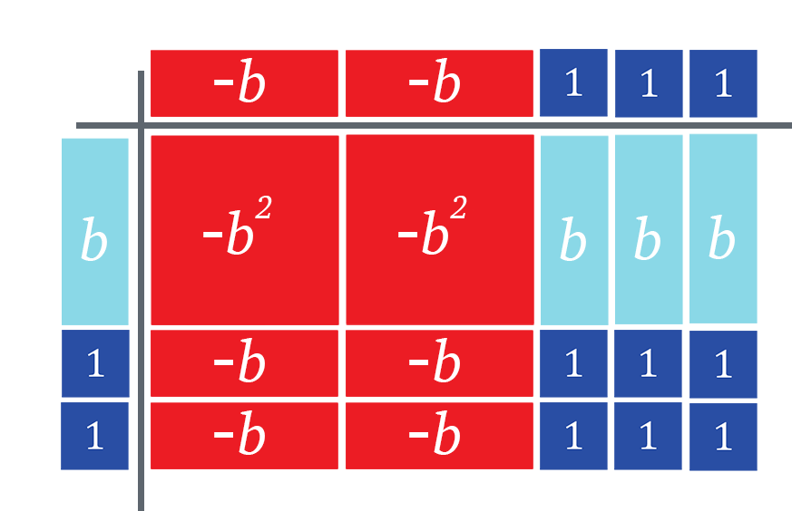
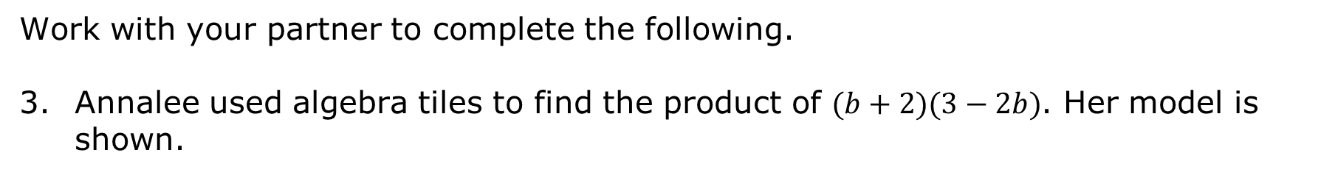
Work with your partner to complete the following.
Annalee used algebra tiles to find the product of $(b+2)(3−2b)$. Her model is shown.
volume 1, pg. 89

Slide 19
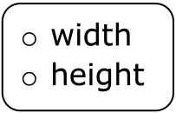
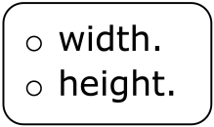
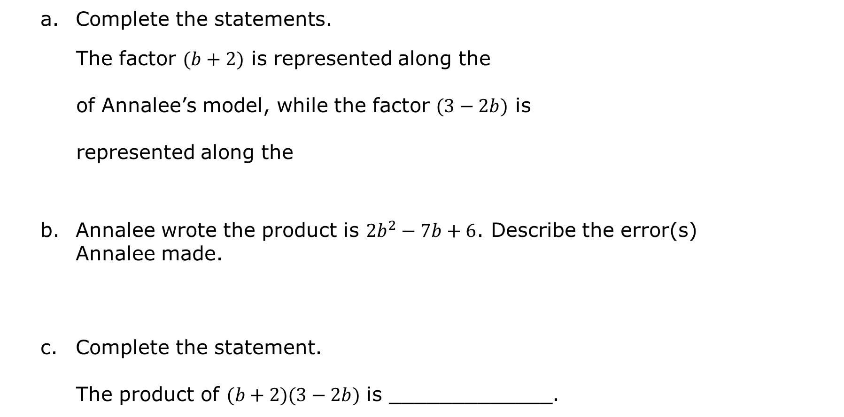
Complete the statements.
The factor $(b+2)$ is represented along the
of Annalee’s model, while the factor $(3−2b)$ is represented along the
Annalee wrote the product is $2b^{2}−7b+6$. Describe the error(s) Annalee made.
Complete the statement.
The product of $(b+2)(3−2b)$ is _____________.
volume 1, pg. 89

Slide 20

Guided Practice
volume 1, pg. 90

Slide 21


2.6.4 Guided Practice: Multiplying Binomials
Use algebra tiles to find the product of $(1−r)(4r−1)$.
$\left(1−r\right)\left(4r−1\right)=$________________.
volume 1, pg. 90

Slide 22

Find the product of ${\left(4x+1\right)}^{2}$ using algebra tiles.
${\left(4x+1\right)}^{2}=$ ________________
volume 1, pg. 90

Slide 23

Your Turn
volume 1, pg. 90

Slide 24

2.6.5 Your Turn!
Use algebra tiles to find the product of $(2x−1)(x+6)$.
$(2x−1)(x+6)=$________________
volume 1, pg. 90

Slide 25

Use algebra tiles to find the product of $(x−4)(x+4)$.
$(x−4)(x+4)=$________________
volume 1, pg. 90

Slide 26

Wrap-Up
volume 1, pg. 91

Slide 27

2.6.6 Wrap-Up: Cool Down
Use algebra tiles to find the product of ${\left(x−5\right)}^{2}$.
${\left(x−5\right)}^{2}=$________________
volume 1, pg. 91

